Slide 1
Scaling Agile @ Spotify with Henrik Kniberg
https://www.youtube.com/watch?v=jyZEikKWhAU

Slide 2
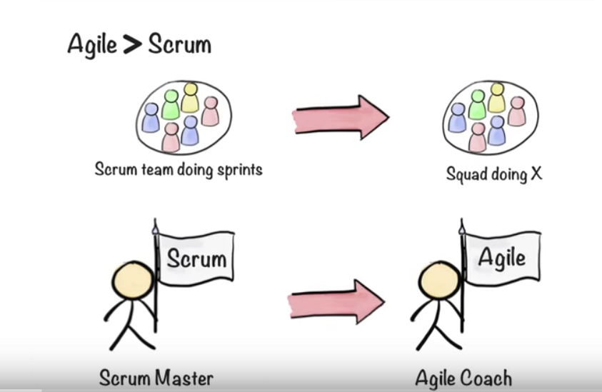
Loose on practice, keep on principles
Notes:
Slaves => Leadership

Slide 3
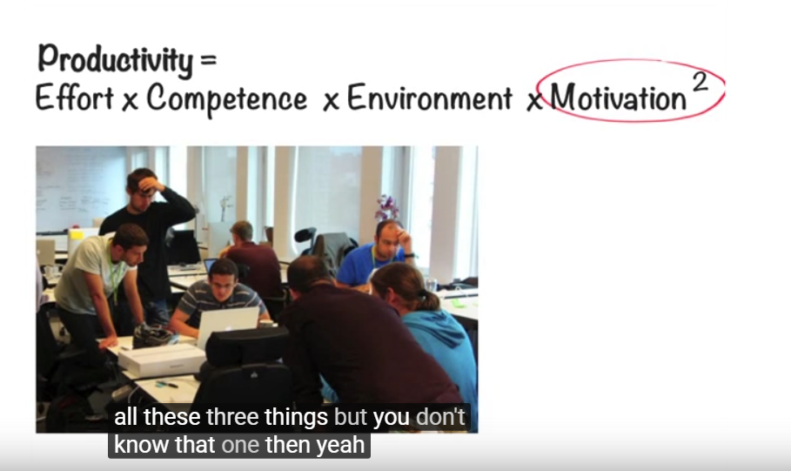
Why autonomy important?
Speed
scaling
motivation

Slide 4
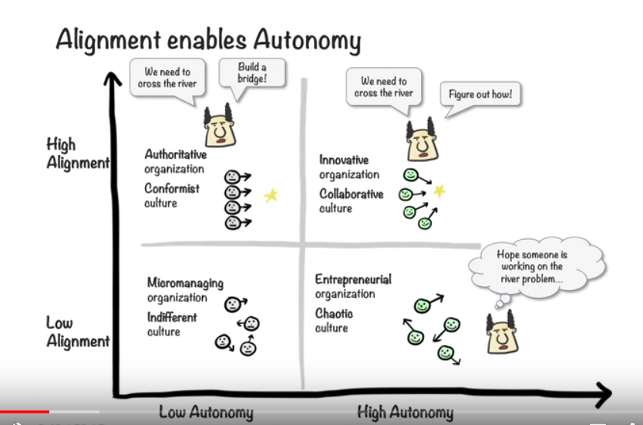
Alignment enables Autonomy

Slide 5
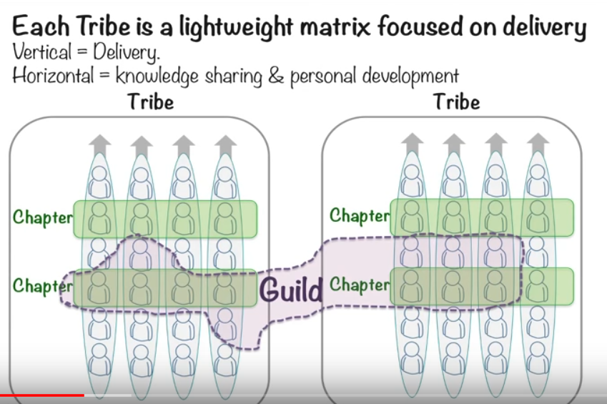
Community > Structure

Slide 6
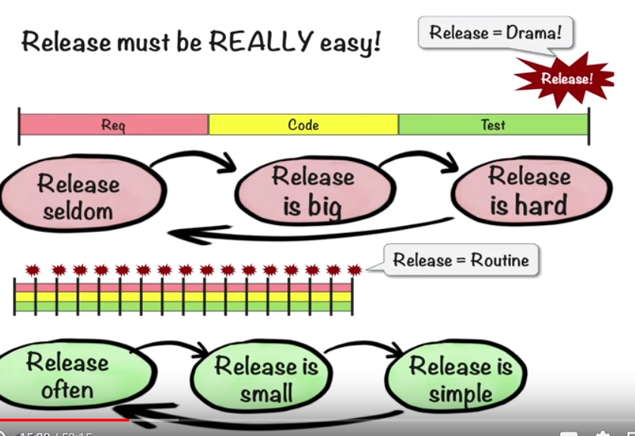
Release must be really easy

Slide 7
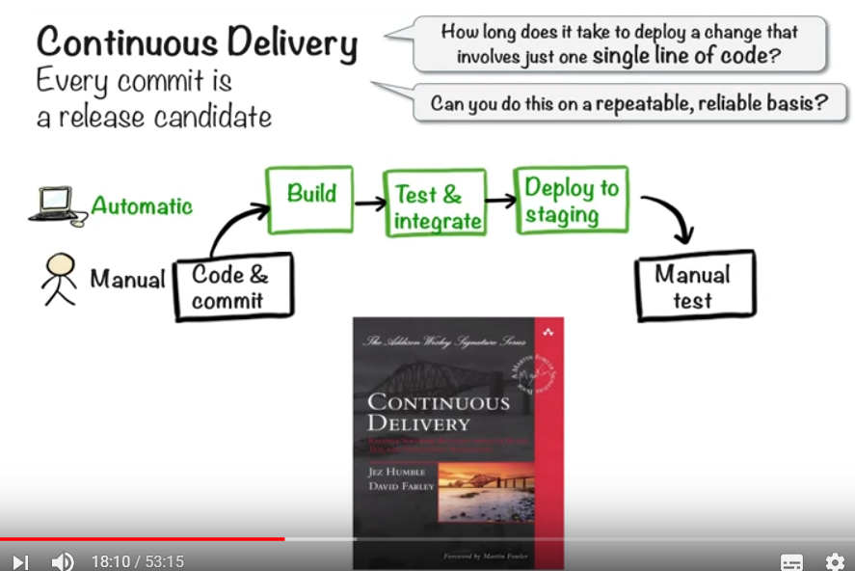
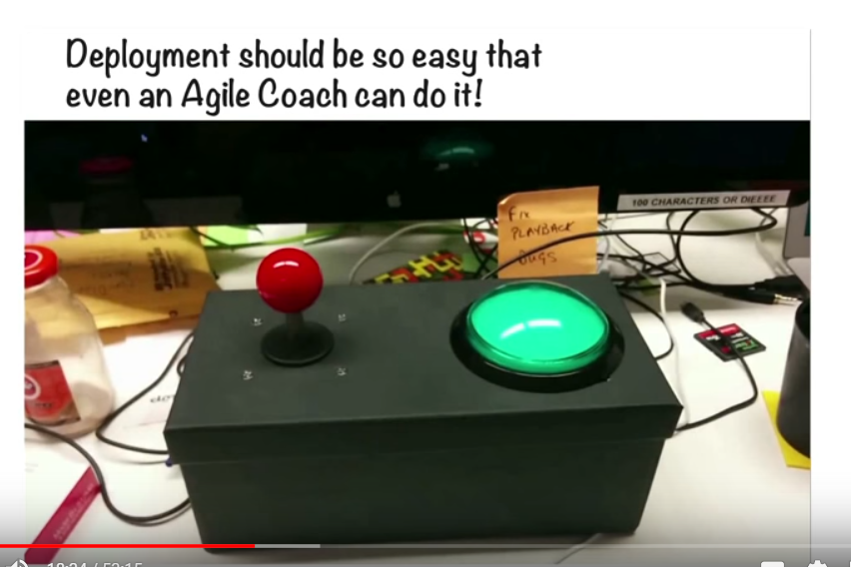
Decoupling to enable frequent releases
Architecture change, organization change, tools, etc
Continuous delivery

Slide 8
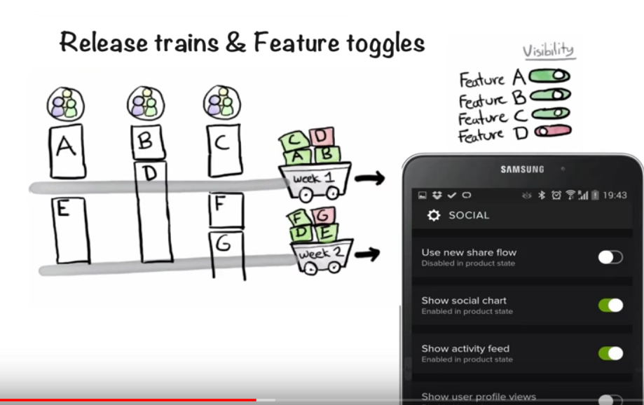
Release train & Feature toggles

Slide 9
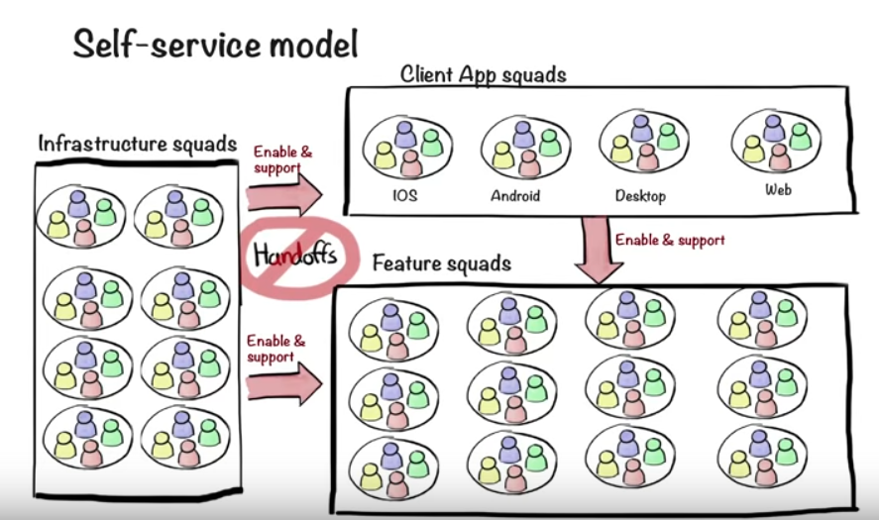
Self-service model => no handoff

Slide 10
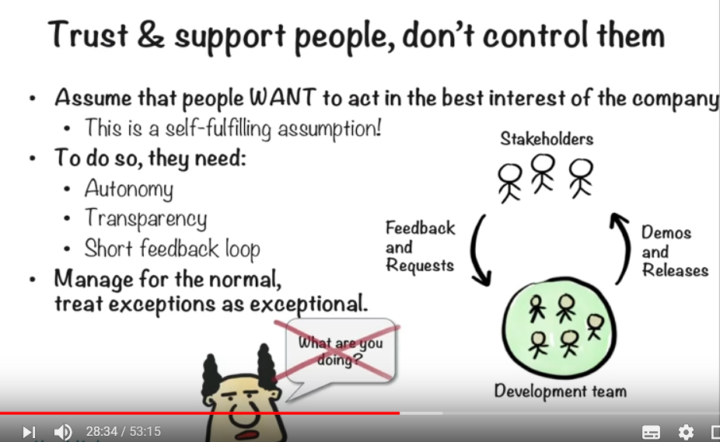
Trust > control

Slide 11
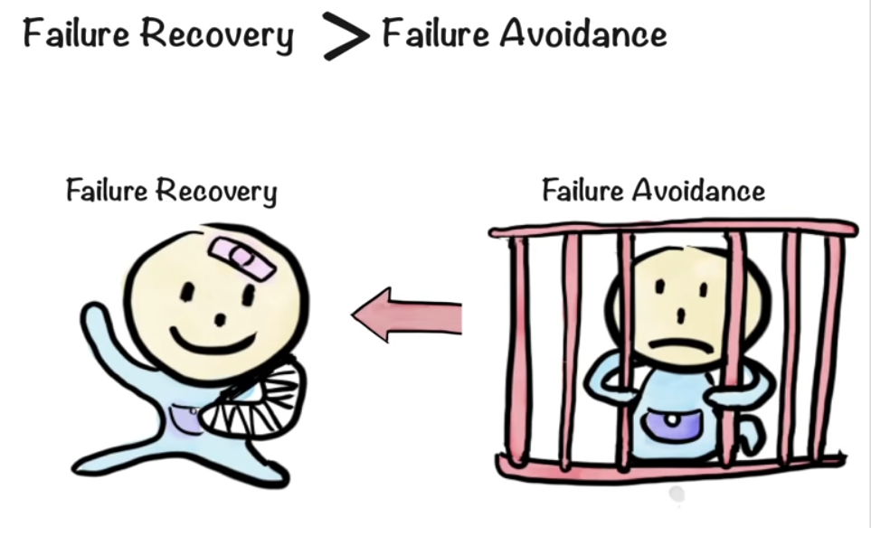
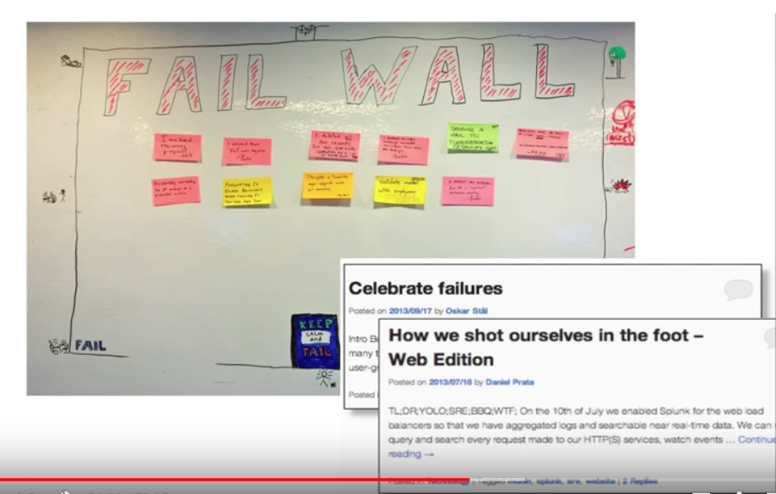
Failure recovery > failure avoidance
Fail Fast => Learn Fast => Improve Fast

Slide 12
Limited blast radius
via decoupled architecture
via gradual rollout

Slide 13
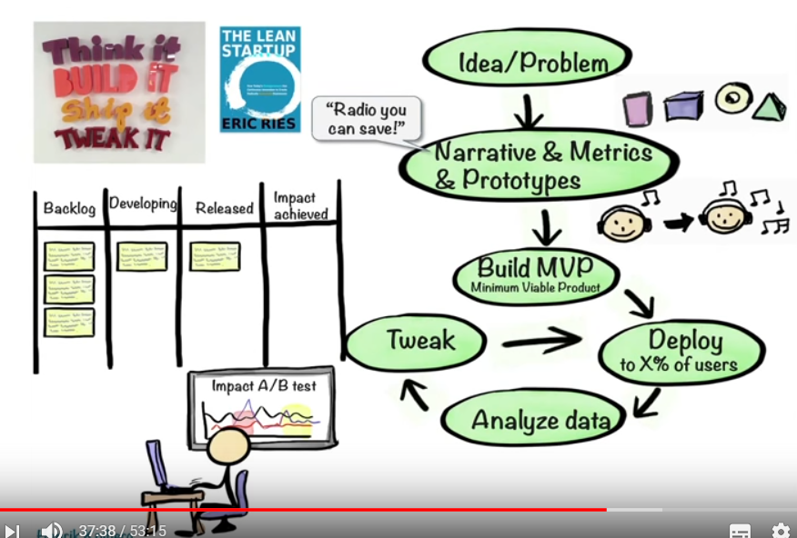
Lean startup
Think it
Build it
Ship it
Tweak it

Slide 14
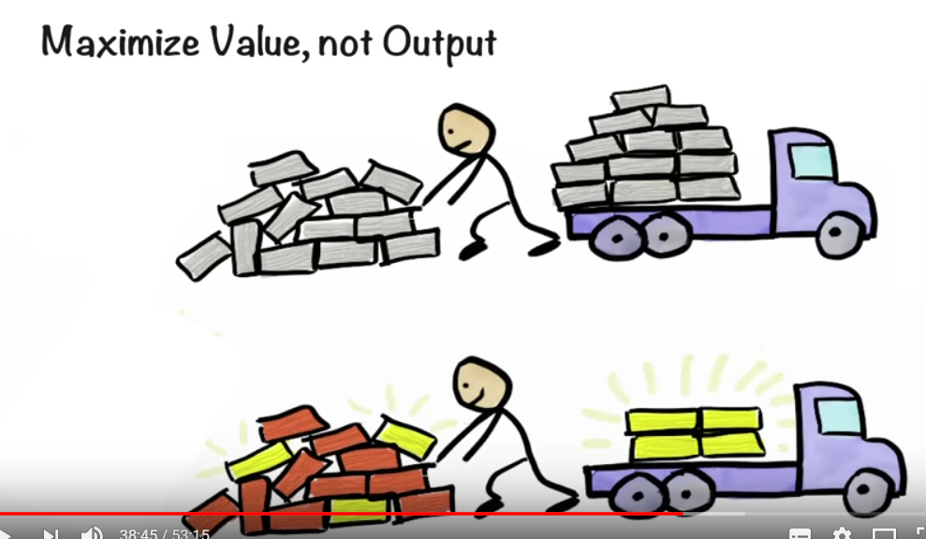
Maximize Value, not Output

Slide 15
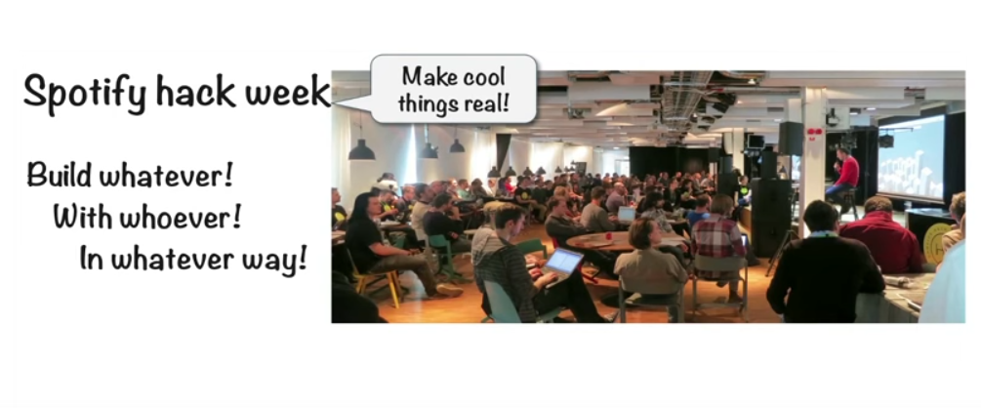
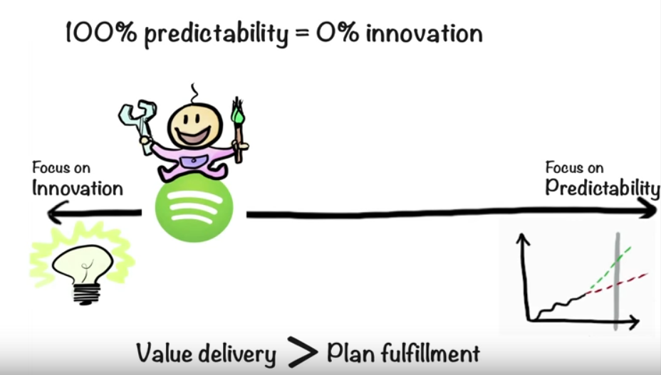
Innovation > Predictability

Slide 16
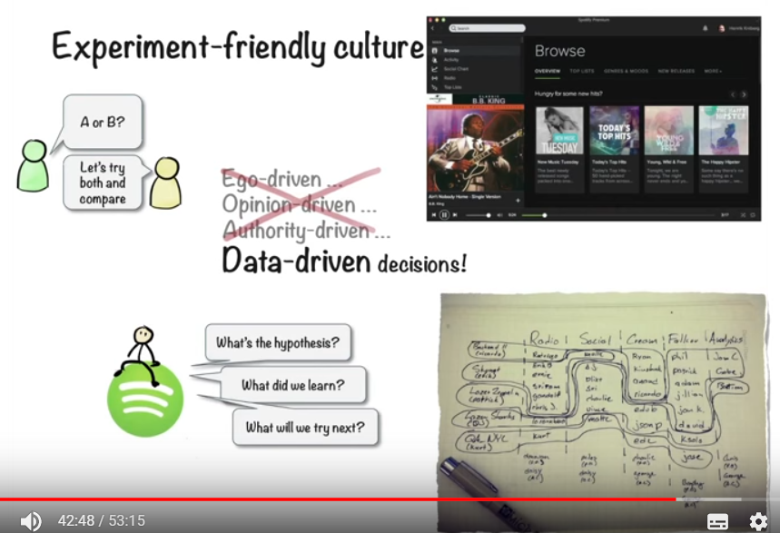
Experiments > Argument

Slide 17
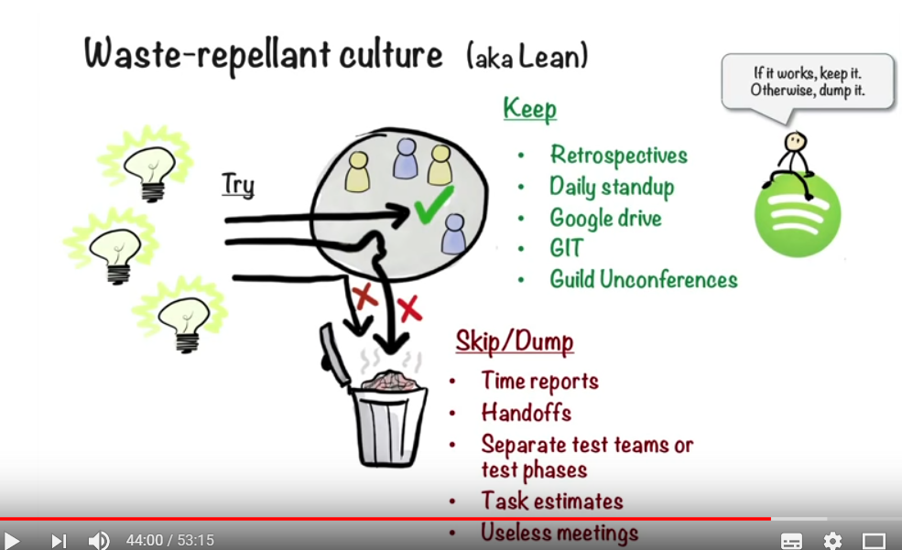

Slide 18
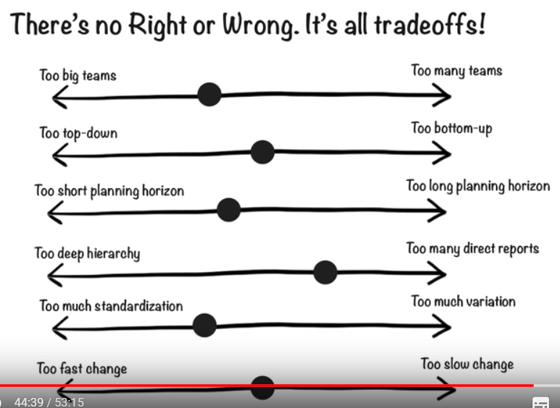
tradeoffs

Slide 19
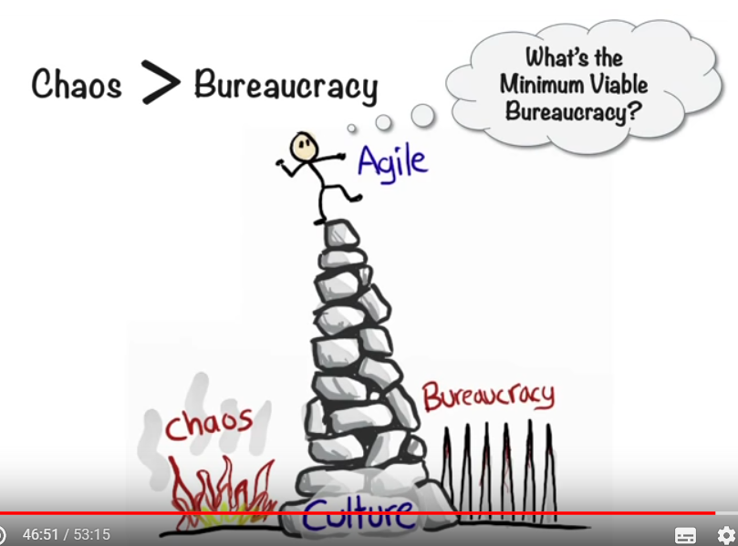
Chaos > Bureaucracy

Slide 20
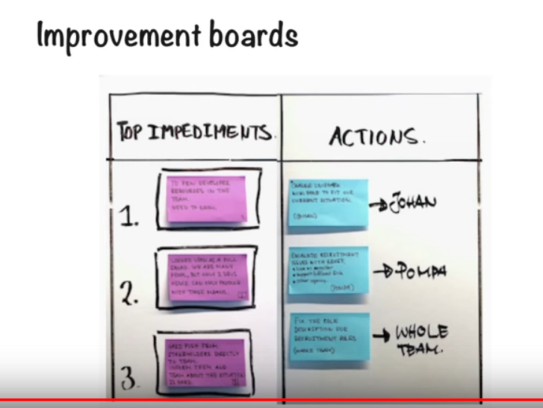
Continuous improvement - 1

Slide 21
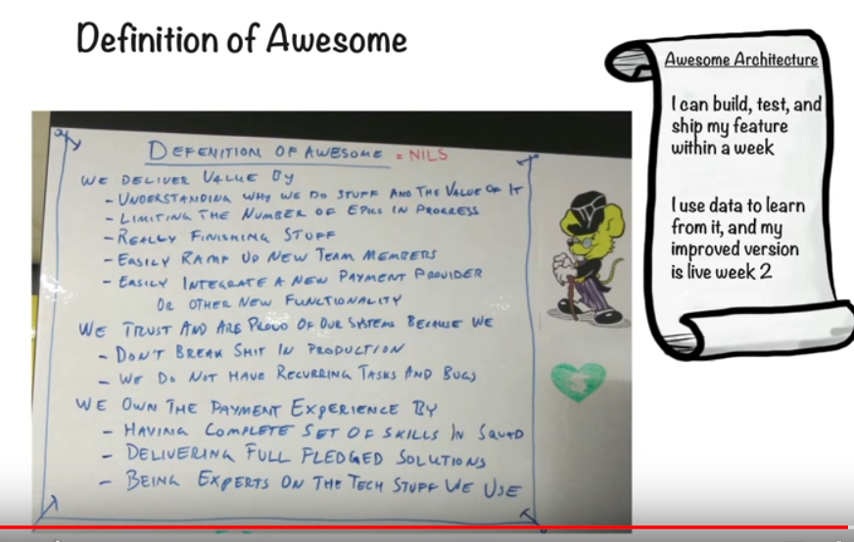
Continuous improvement - 2

Slide 22
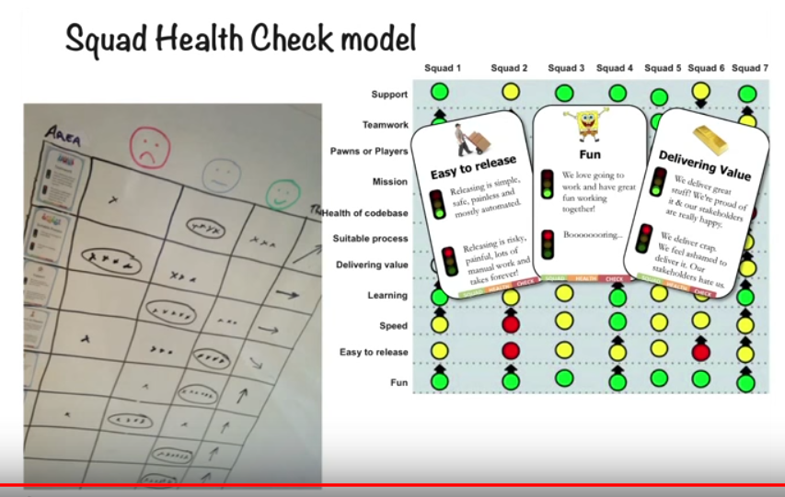
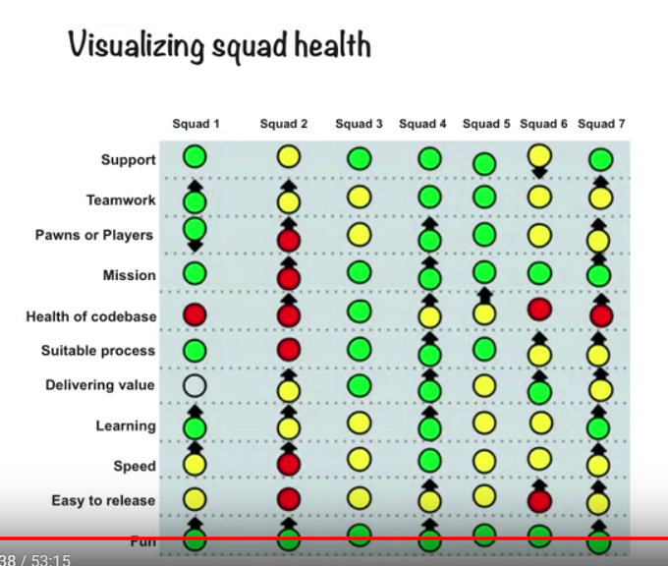
Continuous improvement - 3

Slide 23
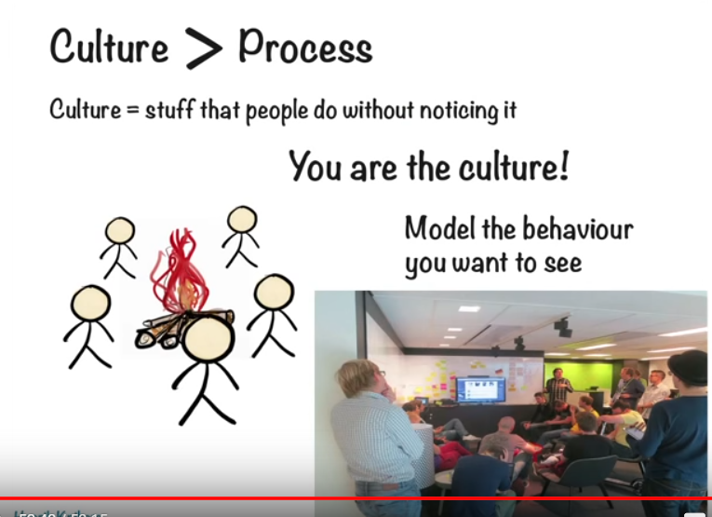
Culture > Process

Slide 24
The End

